Slide 1
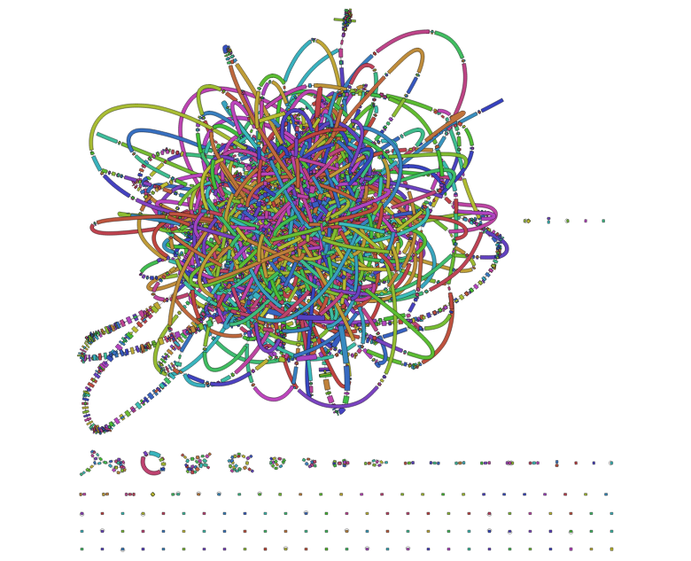
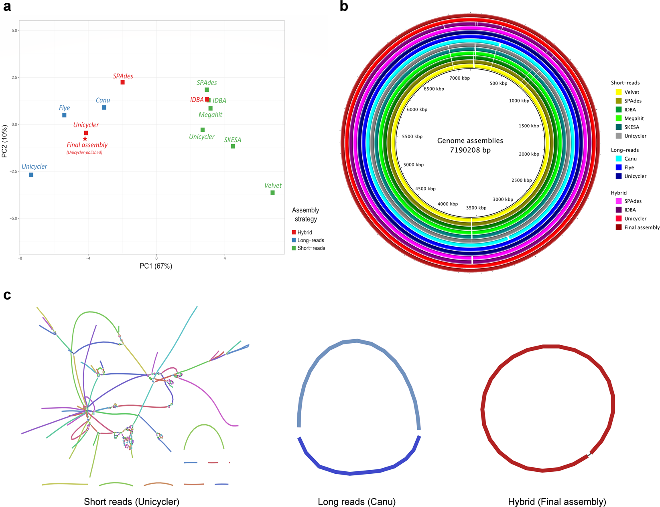
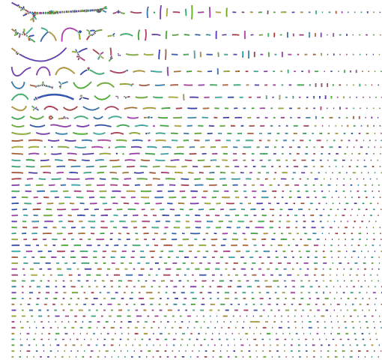
Genome Assembly
The good …. the bad … and the ugly

Slide 2

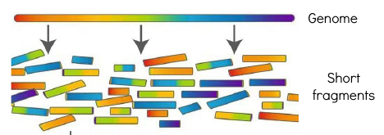
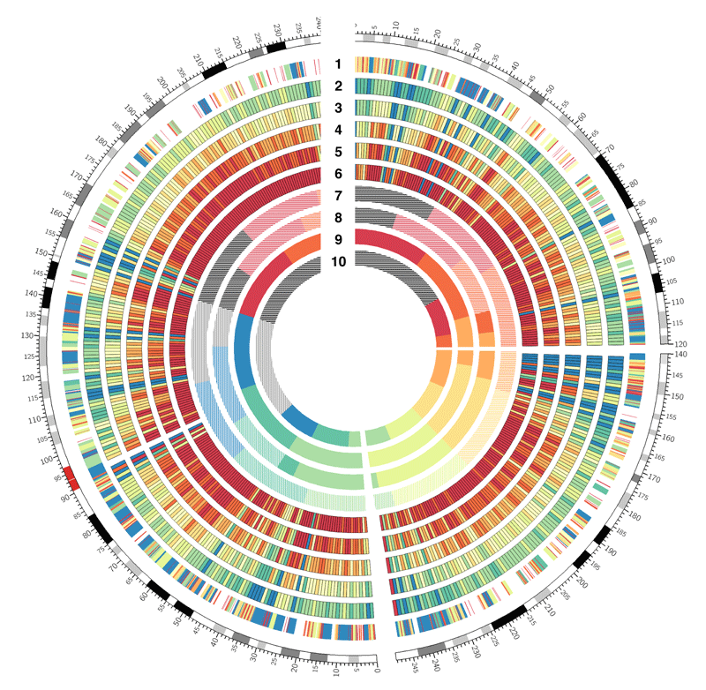
What to do with raw data
1. compare
- against a database
- against a reference genome

Slide 3
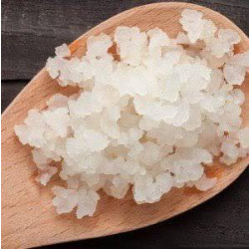
What to do with raw data
1. compare
- against a database
- against a reference genome
Only useful if we already have a good reference or knowledge of the organism!
?
?
?

Slide 4
What to do with raw data
1. compare
- against a database
- against a reference genome
2. Genome assembly
- Definition: to reconstruct the original sequence (genome) from the sequenced reads
many sequencing
reads
contiguous sequence

Slide 5

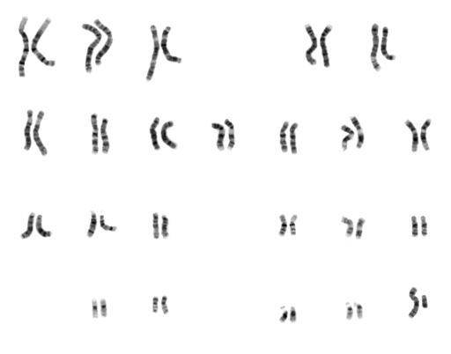
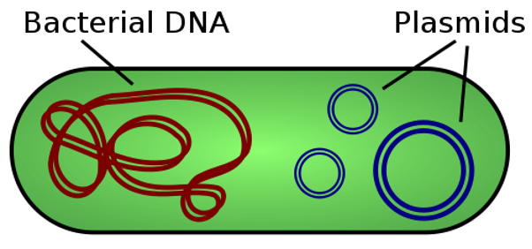
Assemble a contiguous sequence
...many sequences
(eukaryotes)
...~one sequence
(prokaryotes)
Essentially the same computational approach for assembling prokaryotic and eukaryotic genomes.
...just much more complex for eukaryotes.

Slide 6
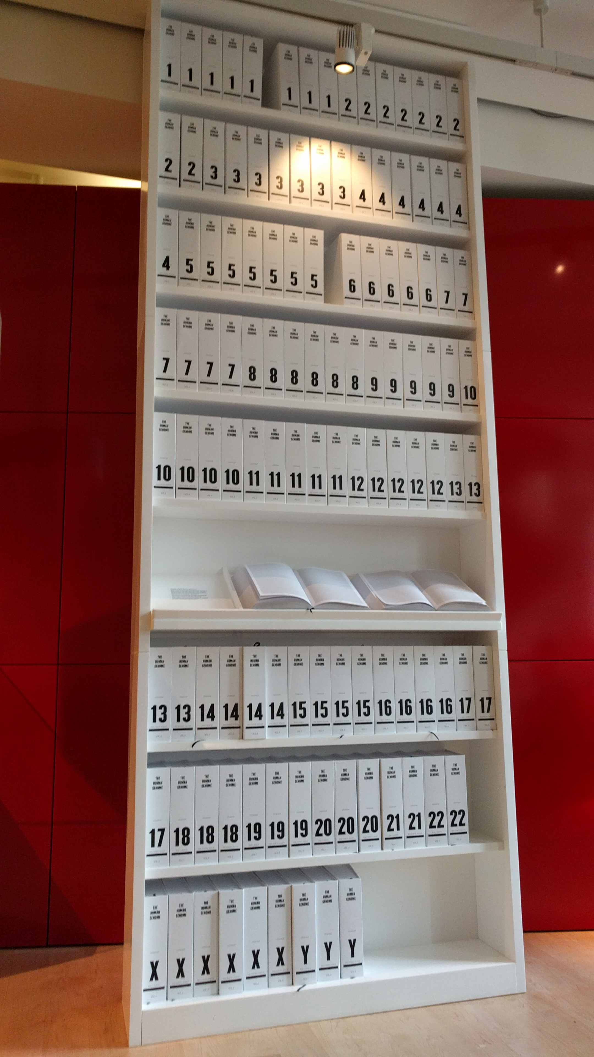
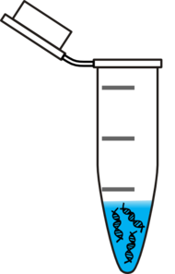
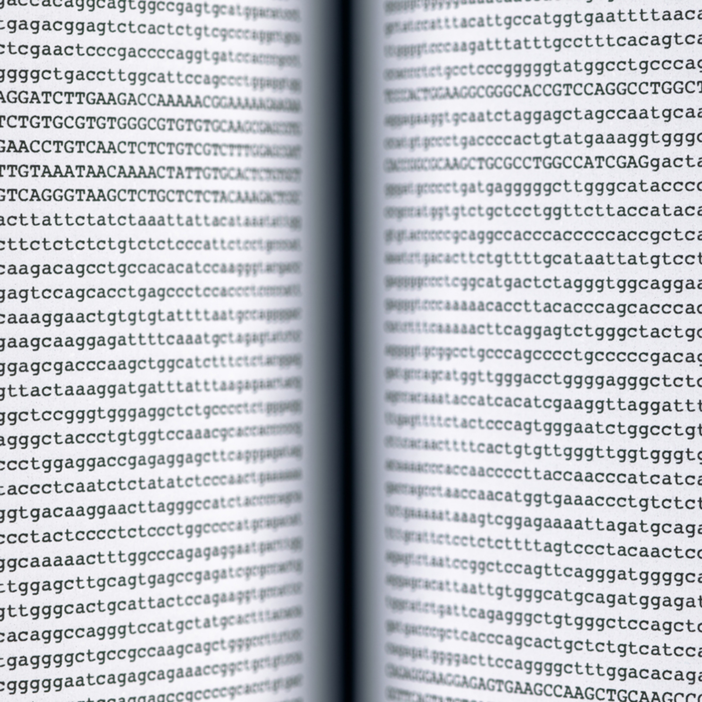
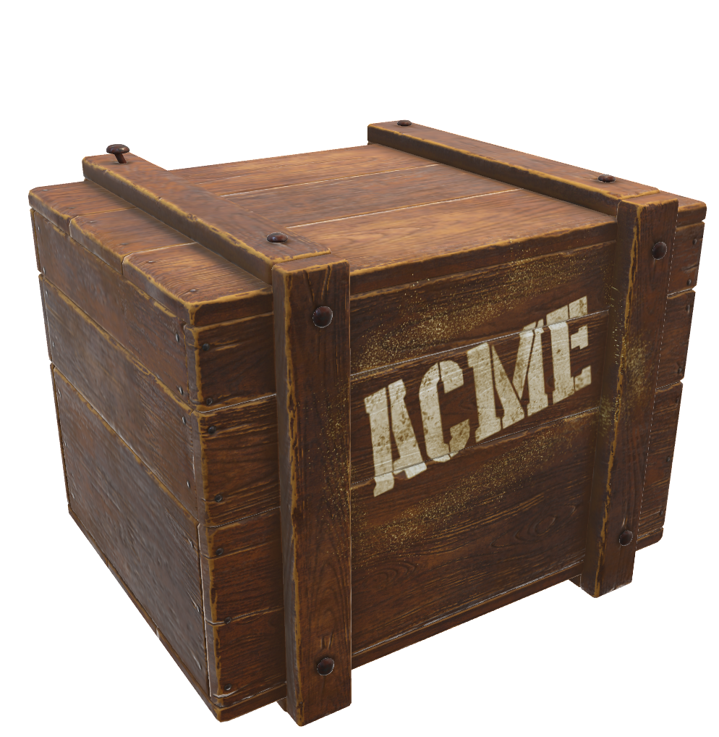
Ideally…

Slide 7

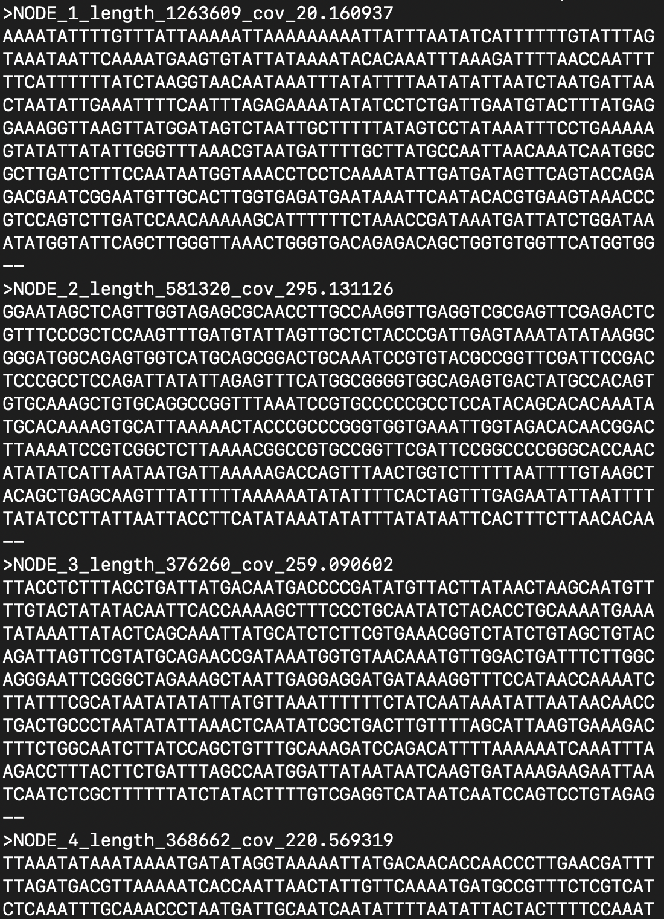
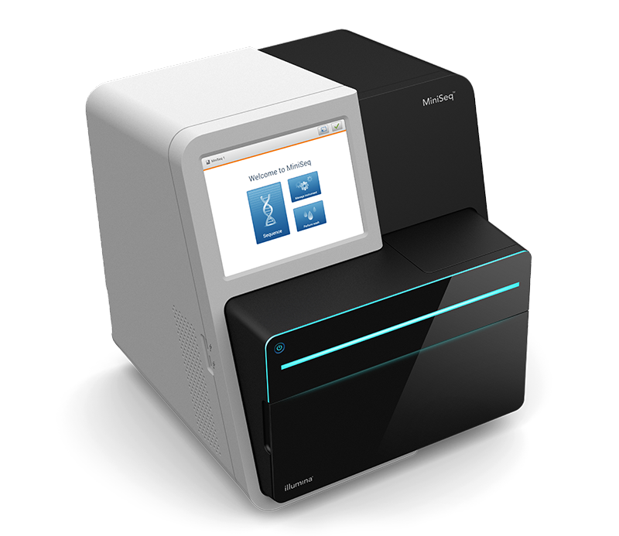
In reality…
AKA: the hair-ball

Slide 8

The Problem: Fragmentation
In order to sequence a genome (with Illumina) we have to make a detour and fragment the DNA
Sequencing information is stored in .fastq file

Slide 9

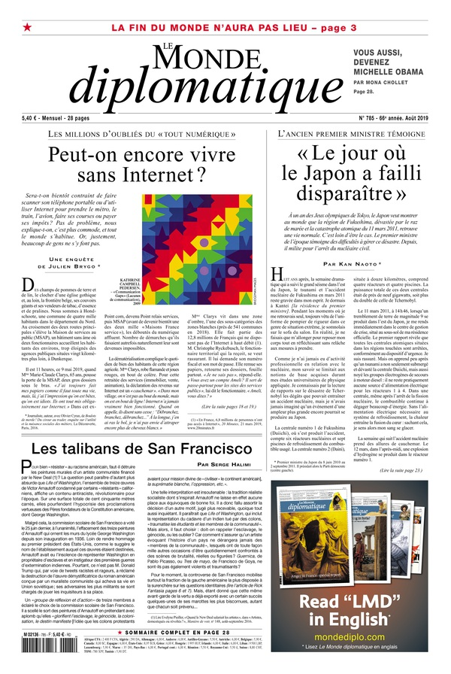

The Problem: Fragmentation
fastq
De novo assembled genome
*de novo = without any previous knowledge

Slide 10

The Problem: Fragmentation
fastq
De novo assembled genome

Slide 11
The Problem: Fragmentation
fastq
How can we assemble a genome?
Why can’t we assemble a genome?
How can we check our assembly?
De novo assembled genome

Slide 12
1. How can we assemble a genome?
Ground truth (~genome):
…..cctctagctagcgttc
gggcatcggatttctcacc
tattctttcggcggattaca
gatcgtacgtacgtagcta
atatatgctcagtcagtgac….

Slide 13
1. How can we assemble a genome?
Let’s use an analogy…
Song lyrics
https://training.galaxyproject.org/archive/2022-07-01/topics/assembly/tutorials/general-introduction/slides-plain.html

Slide 14
1. How can we assemble a genome?
Ground truth (~genome):
Is this the real life?
Is this just fantasy?
Caught in a landside,
No escape from reality

Slide 15

1. How can we assemble a genome?
Ground truth (~genome):
Is this the real life?
Is this just fantasy?
Caught in a landside,
No escape from reality
Bohemian Rhapsody (Queen)

Slide 16
The reads:
Is thi
this the rea
e real life?
Is thi
his just fa
ust fantasy?
Caught i
ht in a land
in a landside,
No esc
scape fro
e from reality

Slide 17
The reads:
Is thi
this the rea
e real life?
Is thi
his just fa
ust fantasy?
Caught i
ht in a land
in a landside,
No esc
scape fro
e from reality
The overlaps:
Is thi
this the rea
e real li
e roal life?
Is thi
his jast fa
just fa
ust fantasy?
Caugzt I
aught in
ht in a land
in a landside,
No esc
scape fro
e from reality
errors

Slide 18
The reads:
Is thi
this the rea
e real life?
Is thi
his just fa
ust fantasy?
Caught i
ht in a land
in a landside,
No esc
scape fro
e from reality
The overlaps:
Is thi
this the rea
e real li
e roal life?
Is thi
his jast fa
just fa
ust fantasy?
Caugzt I
aught in
ht in a land
in a landside,
No esc
scape fro
e from reality
The majority consensus:
Is this the real life?
Is this just fantasy?
Caught in a landside,
No escape from reality
errors

Slide 19
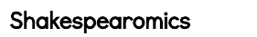
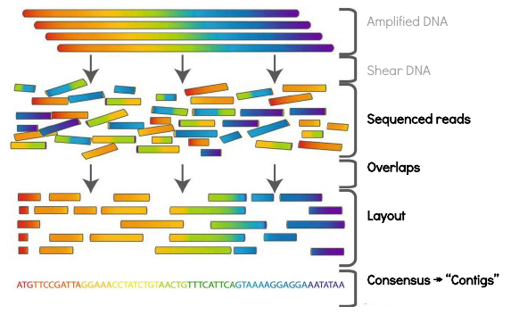
In the context of genomes…
The reads:
Is thi
this the rea
e real life?
Is thi
Genomics
The overlaps:
Is thi
this the rea
e real li
e roal life?
The majority consensus:
Is this the real life?
Is this just fantasy?
Caught in a landside,
No escape from reality

Slide 20
Genome assembly algorithms
Overlap-layout-consensus
De Bruijn graphs
Greedy assembly
String graphs
seed and extend

Slide 21
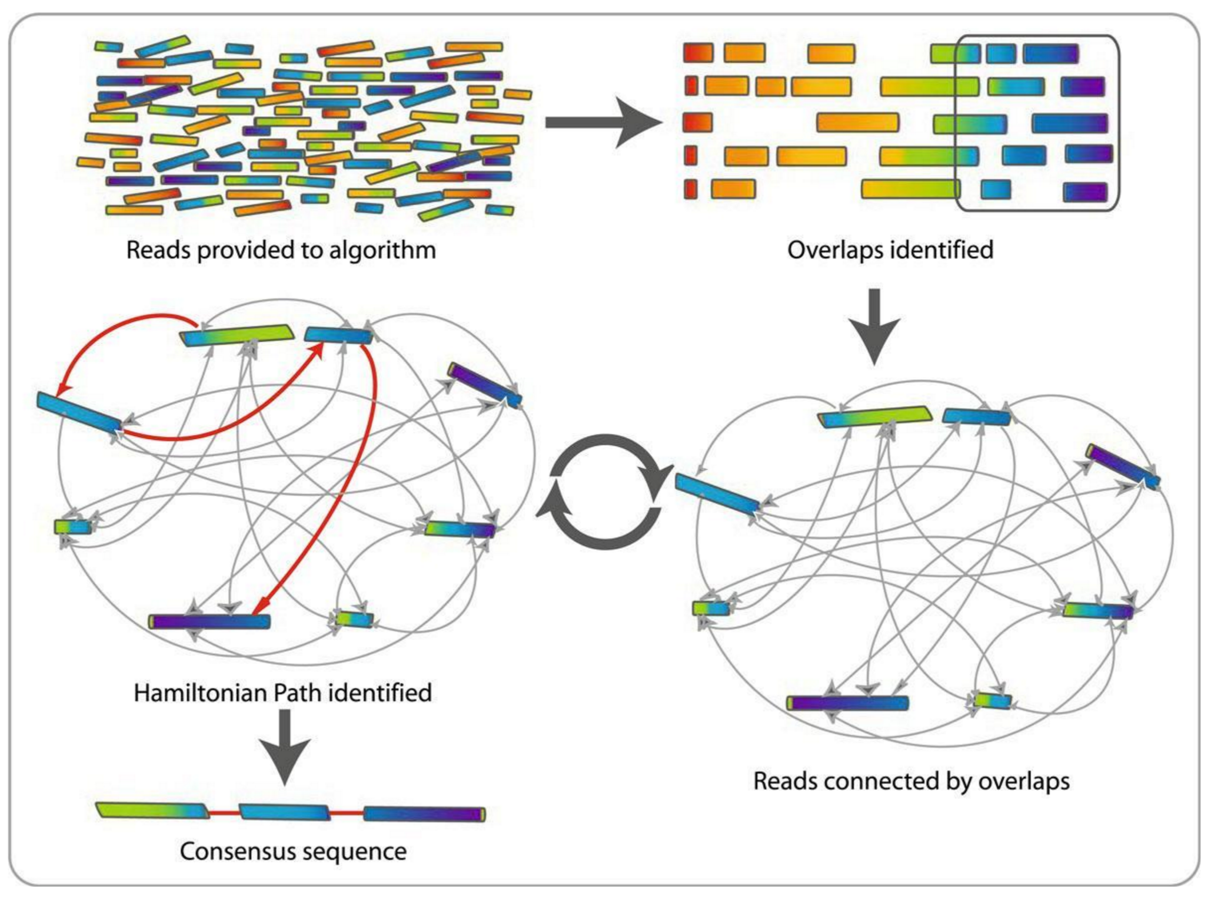
Overlap-layout-consensus

Slide 22
Overlap stage
Overlap stage: During this stage all overlaps between the reads are scanned and the graph structure is computed.

Slide 23
Layout stage
Layout stage: The graph is simplified by removing redundant information. Graph algorithms are then used to determine a layout (relative placement) of the reads along the genome.

Slide 24
Consensus stage
Consensus stage: The assembler builds an alignment of all the reads covering the genome and infers, as a consensus of the aligned reads, the original sequence of the genome being assembled.

Slide 25
Overlap-layout-consensus - application
Overlap-layout-consensus
De Bruijn graphs
Greedy assembly
String graphs
seed and extend
- Historical algorithm: for sanger sequencing (long sequences)
- in use again: for Oxford Nanopore and Pacbio (long sequences)
!!However not applicable for the amount and short size of Illumina sequences!!

Slide 26
Genome assembly algorithms
Overlap-layout-consensus
De Bruijn graphs
Greedy assembly
String graphs
seed and extend
...all essentially doing the same thing, but taking different short cuts.

Slide 27
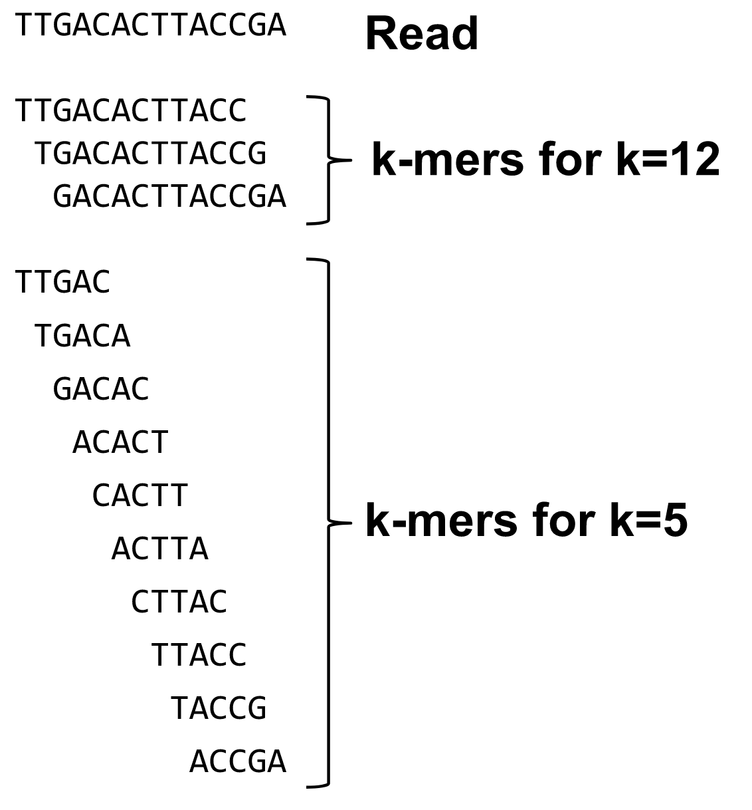
K-mer based approach
kmer=subsequence of length k contained within a biological sequence
Cut read into k-mers of predetermined size
For each k-mer, store info on whether it is present in a read (hashing)
Even more fragmentation!!
Computing with k-mers instead of reads is easier
Hashing (creating a database of k-mers) is very efficient

Slide 28
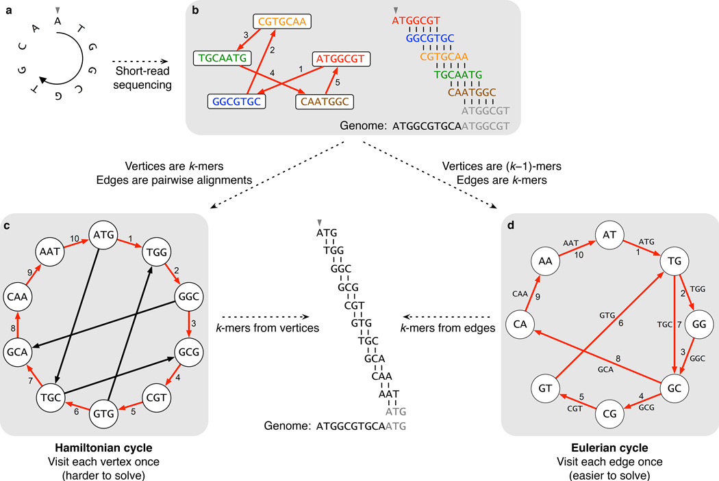
K-mer based approach
Make a node for each k-mer appearing as a consequetive substring in the reads
Connect k-mers that overlap in all but one base on either end eg. ATG and TGC
Find a cycle that uses these paths and covers all the k-mers exactly once!
For some trivia and more info: https://www.nature.com/articles/nbt.2023

Slide 29
K-mer based approach
Make a node for each k-mer appearing as a consequetive substring in the reads
Connect k-mers that overlap in all but one base on either end eg. ATG and TGC
Find a cycle that uses these paths and covers all the k-mers exactly once!
This is the harder than it seems!
(Hamiltonian problem)
For some trivia and more info: https://www.nature.com/articles/nbt.2023

Slide 30
K-mer based approach
Make a node for each k-mer appearing as a consequetive substring in the reads
Connect k-mers that overlap in all but one base on either end eg. ATG and TGC
Find a cycle that uses these paths and covers all the k-mers exactly once!
This is the harder than it seems!
(Hamiltonian problem)
The first microbial genome, 1995
The human genome, 2001
But too computationally intensive!
For some trivia and more info: https://www.nature.com/articles/nbt.2023

Slide 31
De Bruijn graph (kmer based)
K-mers represented by edges
Genome described by a path where each edge is used once
Modern solution, easier to handle
For some trivia and more info: https://www.nature.com/articles/nbt.2023

Slide 32
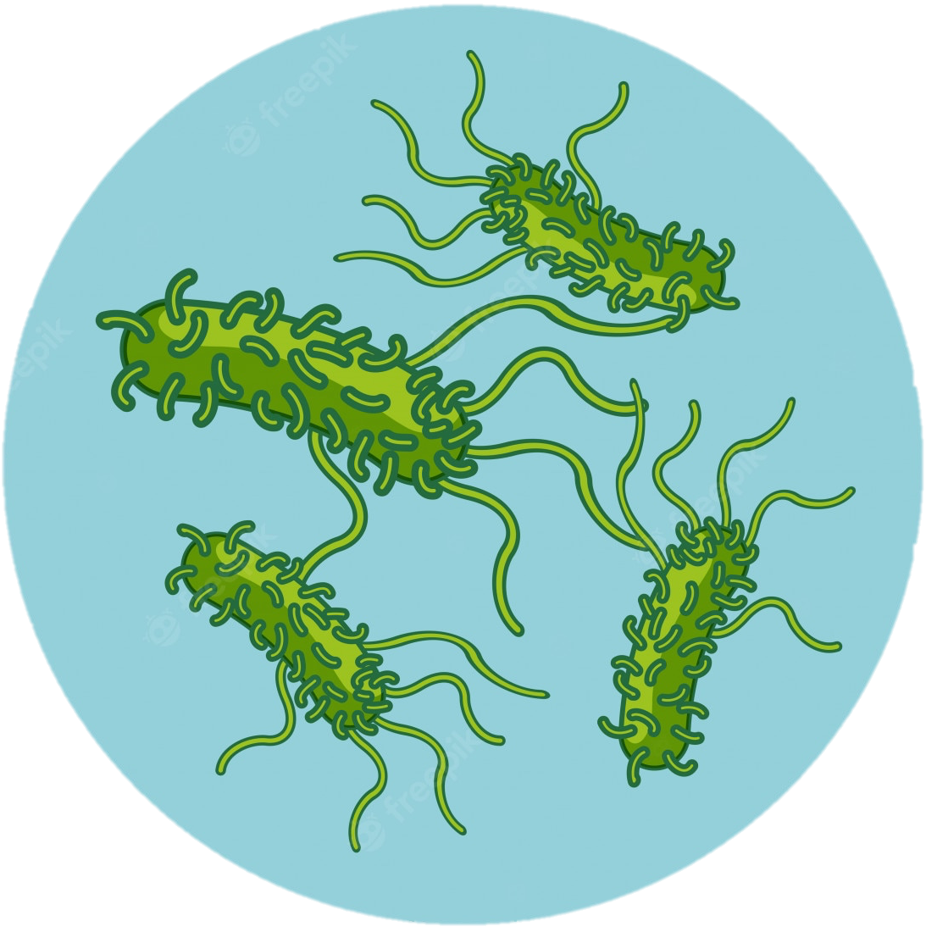
What is the optimal k-mer size?
Example:
Salmonella genome
5.1 Mbp = 5,100,000 base pairs
In 100bp Illumina reads

Slide 33

What is the effect of k-mer size?
k-mer size 51
k-mer size 91
AKA: the hair-ball
Disconnected paths
For some more info: https://github.com/rrwick/Bandage/wiki/Effect-of-kmer-size

Slide 34
Small k-mer size
k-mer size 51
Ideal k-mer length depends on read length, read depth and genome complexity.
Small k-mers are useful in low-coverage regions to reduce fragmentation
More paths connecting the same k-mers, collapse repeats together, leading to the hair-ball
AKA: the hair-ball
For some more info: https://github.com/rrwick/Bandage/wiki/Effect-of-kmer-size

Slide 35
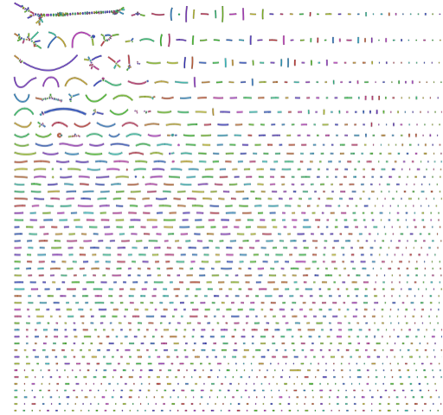
Large k-mer size
k-mer size 91
Ideal k-mer length depends on read length, read depth and genome complexity.
Higher chance of missing overlaps leading to disconnected paths
Useful in high coverage regions to reduce collapsing repeats
Disconnected paths
For some more info: https://github.com/rrwick/Bandage/wiki/Effect-of-kmer-size

Slide 36

What is the solution?
What does the SPAdes assembler do?

Slide 37
SPAdes assembler
- error-correction: very rare k-mers (probably sequencing errors) corrected
Bankevich et al; 2012

Slide 38
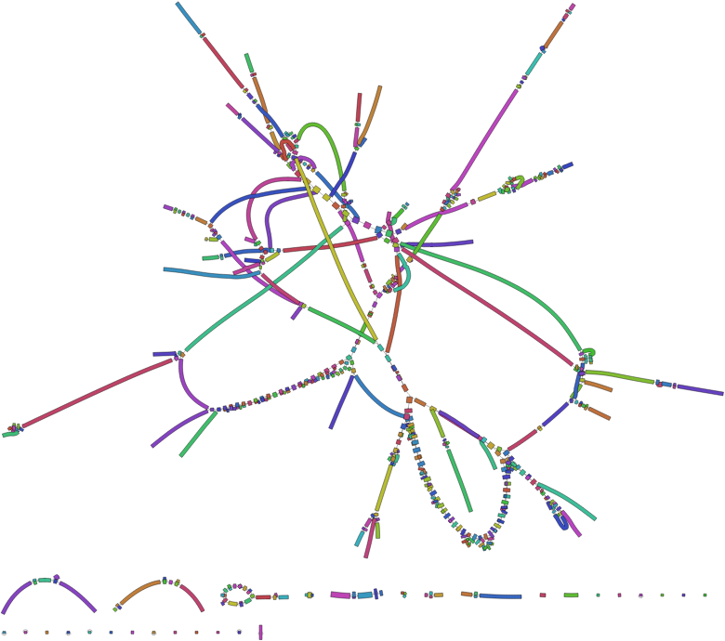
What is the effect of k-mer size?
k-mer size 51
k-mer size 71
k-mer size 91
AKA: the hair-ball
Less complex, fewer fragments
Disconnected paths
For some more info: https://github.com/rrwick/Bandage/wiki/Effect-of-kmer-size

Slide 39
SPAdes assembler
- error-correction: very rare k-mers (probably sequencing errors) corrected
- varying k-mer sizes over assembly because different parts of the genome may have different optimal k-mer length!
Bankevich et al; 2012

Slide 40
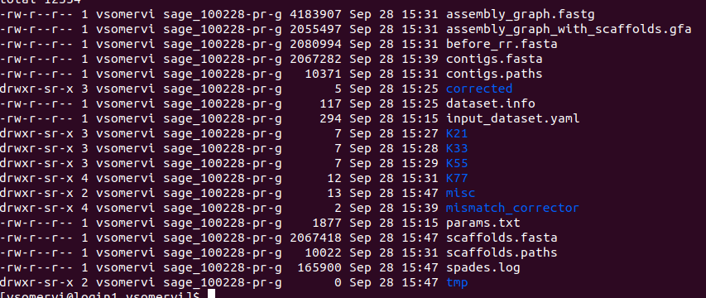
SPAdes assembler
- error-correction: very rare k-mers (probably sequencing errors) corrected
- varying k-mer sizes over assembly because different parts of the genome may have different optimal k-mer length!
Bankevich et al; 2012

Slide 41
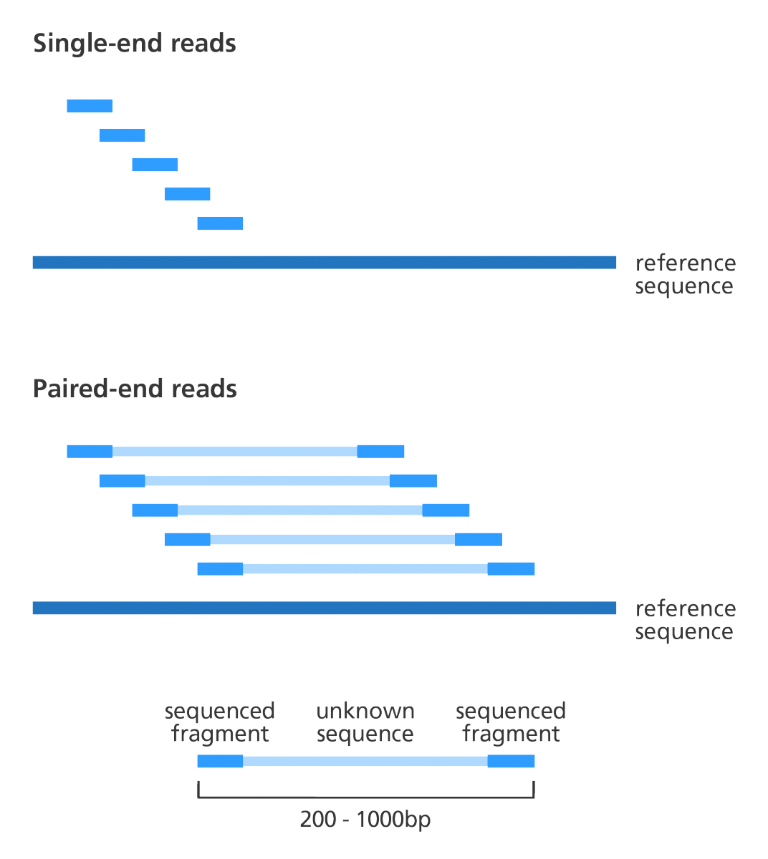
Paired-end reads to the rescue
Paired end reads are useful to in complicated/problematic regions

Slide 42
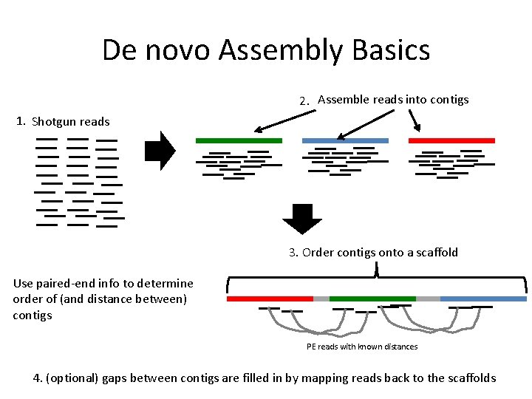
Paired-end reads to the rescue
Paired end reads are useful to in complicated/problematic regions

Slide 43
How can we assemble a genome?
Why can’t we assemble a genome?
How can check our assembly?

Slide 44
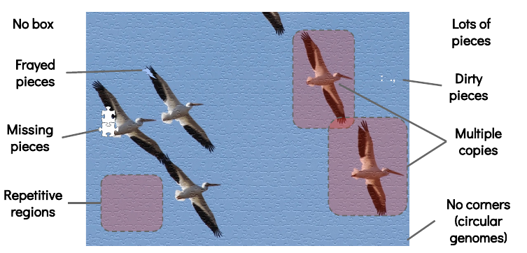
2. Why can’t we assemble a genome?
What are the difficulties in the puzzle? How could this relate to genome assemblies?

Slide 45

2. Why can’t we assemble a genome?
This is what we actually work with!

Slide 46
Challenges (puzzle assembly version)
What are the difficulties in the puzzle?
How could this relate to genome assemblies?

Slide 47
Challenges (genome assembly version)
We don’t actually know
the true sequence!
Millions of reads!
Sequencing
error
Sequencing
error
Sequence
bias
Long
Repeats
Short (tandem)
Repeats

Slide 48
Challenges (genome assembly version)
Many pieces (puzzle with million of pieces)
No box == de novo (no reference picture)
Lots of overlaps (finding pairwise overlaps between reads)
Imperfect sequences (seq error)
Missing pieces (seq bias)
Lots of smart tricks to overcome these problems
If you want to learn morn about the algorithmic side:
→ Bioinformatic Algorithms course
Christophe Dessimoz, David Gfeller

Slide 49
Biological challenges
Long
Repeats
Short (tandem)
Repeats

Slide 50
Short (tandem) repeats
Short segmented that is repeated over and over
Verse 3
I see a little silhouetto of a man
Scaramouche, Scaramouche, will you do the Fandango?
Thunderbolt and lightning, very, very frightening me
Galileo, Galileo, Galileo, Galileo, Galileo Figaro magnifico
But I'm just a poor boy, nobody loves me
He's just a poor boy from a poor family
Spare him his life from this monstrosity
Easy come, easy go, will you let me go?
Bismillah! No, we will not let you go
Let him go, Bismillah! We will not let you go
Let him go, Bismillah! We will not let you go
Let me go, Will not let you go
Let me go, Will not let you go
Never, never, never, never let me go, Ah
No, no, no, no, no, no, no
Oh, mamma mia, mamma mia, Mamma mia, let me go
Beelzebub has a devil put aside for me, for me, for me!

Slide 51
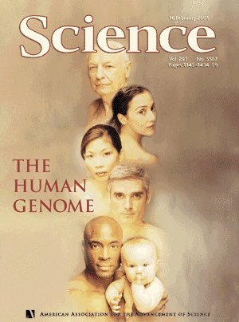
Short (tandem) repeats
- homopolymers
- tandem repeats
Not often a problem in prokaryotic genomes
→ often a problem in eukaryotic genomes
(Telomere and centromere are currently still
not entirely sequenced in human genome)

Slide 52
Long repeats
Segment that occurs more than once
[Verse 1]
Mama, just killed a man
Put a gun against his head, pulled my trigger, now he's dead
Mama, life had just begun
But now I've gone and thrown it all away
Mama, ooh, didn't mean to make you cry
If I'm not back again this time tomorrow
Carry on, carry on as if nothing really matters

Slide 53

Long repeats
Segment that occurs more than once
- multicopy genes (most prominent rRNA)
- mobile elements (transposable elements (Ctrl +C/V))
- tandem gene duplications

Slide 54
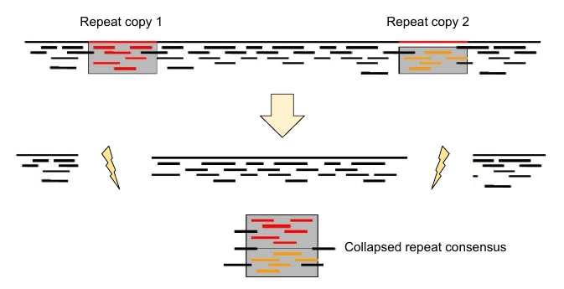
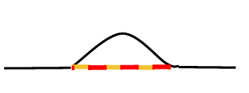
What do repeats do to assemblies?
Fragmentation
Repeat collapse
Not assembly of the repeat
→ contig edges are often caused by repeats and are error prone
Repeats are assembled together (hybrid)
→ check high coverage regions

Slide 55
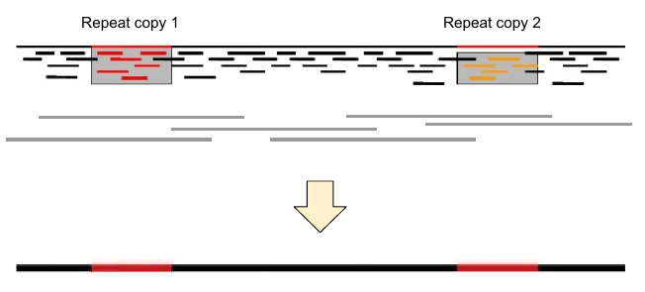
How do we deal with repeats?
The law of repeats
It is impossible to resolve repeats of length X unless you have reads longer than X
→ long reads (Oxford Nanopore, Pacbio)
Anchor read on
either side of
the repeat

Slide 56
How can we assemble a genome?
Why can’t we assemble a genome?
How can check our assembly?

Slide 57
3. How can we check our assembly?
Contiguity
Completeness
Correctness

Slide 58
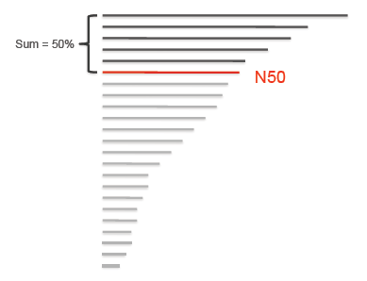
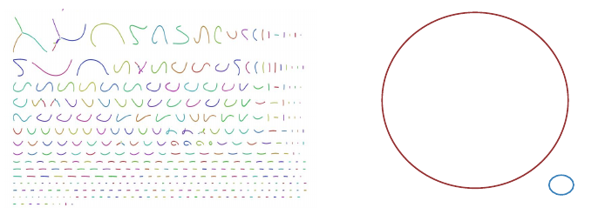
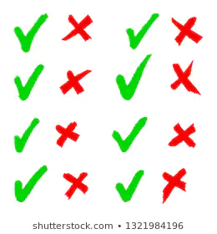
Contiguity
Desire
Fewer contigs
Longer contigs
Metrics
Number of contigs
Mean contig length
Max. contig length
N50 (The N50 is the size of the smallest of all the large contigs covering 50% of the genome)

Slide 59
Completeness
Proportion of original/reference genome represented by the assembly
Assembled Genome Size
Between 0 and 1
Estimated Genome Size
Disclaimer:
Very crude method and restricted to “model” systems were you already have references

Slide 60



Completeness: core genes
Looking for core genes in the assembly.
Core genes are genes that are assumed to be present in every Genome.
Pointy ears
cute
whiskers
tail
fur

Slide 61

Completeness: core genes
Looking for core genes in the assembly.
Core genes are genes that are assumed to be present in every Genome.
Pointy ears
cute
whiskers
60% complete cat
tail
fur

Slide 62
Correctness : How to check?
Proportion of the assembly that is free from mistakes (hard to assess)
Map all reads back against the genome and look for:
genome
reads

Slide 63
Correctness : How to check?
Proportion of the assembly that is free from mistakes (hard to assess)
Map all reads back against the genome and look for:
Repeat collapsed (high coverage)
genome
genome
reads
reads
Multicopy
gene

Slide 64
Correctness : How to check?
Proportion of the assembly that is free from mistakes (hard to assess)
Map all reads back against the genome and look for:
Repeat collapsed (high coverage)
genome
genome
reads
reads
Multicopy
gene
Mis-assembly (no coverage)
reads
mis-assembly

Slide 65
Correctness : How to check?
Proportion of the assembly that is free from mistakes (hard to assess)
Map all reads back against the genome and look for:
Repeat collapsed (high coverage)
genome
genome
reads
reads
Multicopy
gene
Mis-assembly (no coverage)
SNVs (systematic error)
genome
reads
reads
mis-assembly
SNV (single nucleotide variant)

Slide 66
Do we have enough reads?
genome
reads
Spades works best with a coverage of 20x
How can we calculate the average expected genome coverage?
(Number of reads * read length) / genome size
*let’s consider 3mb as an average genome size. (3’000’000 bp)
*let’s consider 120 bp as an average read length
(473’209 * 120bp) / 3’000’000 bp = 18.92836 x

Slide 67
What else can be assembled?
- Transcriptome
- Metagenomes
- Metatranscriptome

Slide 68
Take-home messages
De novo assembly is the process of reconstructing a long sequence from many short ones (without prior information)
Overlap-layout-consensus is a common theme in all genome assembly algorithms and modern assemblers use De Bruijn graphs
We can assemble anything! (…almost) It is very challenging (“impossible”) mainly because of repeats
Contiguity, Completeness and Correctness are three important quality control properties

Slide 69
Resources
Slides:
Torsten Seemann
Marc Robinson-Rechavi
Kirsten Ellegaard
Vincent Sommerville
Papers:
Commins et al; 2009
Pevzner et al; 2011
Schatz et al; 2010
Bankevich et al; 2012
Other references mentioned on slides

